Slide 1

SCF IS @ MSC 96
Ship Construction File (SCF)
Status Report on the Development of
SCF Industry Standard to be noted by IMO
(MSC 96/5/7 and MSC 96/INF.9)
by Dr. Ralf Sören Marquardt
Maritime Safety Committee – 96th session
12 May 2016, IMO, London

Slide 2

SCF IS @ MSC 96
Access Procedures
IP
Level
Location
Design Transparency
Information presented
Practical Access
Intellectual Property
Access Management
IP Protection
AR Holders
SCF IS
Adjusting the Balance
IP Holders

Slide 3




SCF IS @ MSC 96
Four Tier Structure of SCF Provisions
GBS – SOLAS Ch. II-1 Reg. 3.10
= Mandatory SCF Requirements
MSC/Circ. 1343 = Guidance on the
Information to be Included in a SCF
SCF Industry Standard (IS) = Industrial Principles
for Access and IPR Protection incl. Content Definition
SCF Supplementary Guidance (SG) = Models for
Practical Implementation (Procedures)
IS defines principles that have been noted by IMO (MSC 96)
SG provides technical details for Archive Centers / SCF users

Slide 4
SCF IS @ MSC 96
SCF Concept
SCF required by SOLAS GBS and MSC.1/Circ.1343
for Bulk Carries and Oil Tankers
SCF Supplement Ashore
SCF Onboard
High IP Level;
Ordinary IP Level;
need not be on board
need to be on board
at all times
at all times
Shipowner’s Office ashore
Digital SCF Archive Center
Ship

Slide 5



SCF @ Tripartite 2015
SCF in paper format
?

Slide 6



SCF @ Tripartite 2015
SCF Browser

Slide 7
SCF IS @ MSC 96
Final Draft SCF Industry Standard
Table of Contents
47 page document:
4 pg. summary;
5 pg. intro, def., admin.;
34 pg. content;
4 pg. protection.
Executive Summary
1. Introduction
2. Definitions
3. SCF Information
Scope – Format– IP Levels – Location
4. Management of SCF Information
Preparation – Access / Safekeeping – Archive
5. Revision of the Industry Standard
References
Annex: Practical Guidelines for
SCF Information Definition

Slide 8
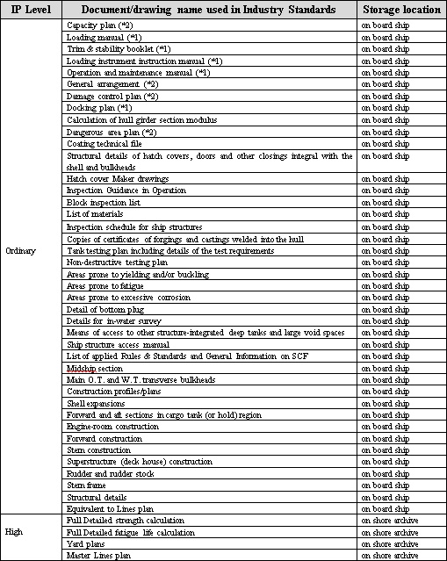
SCF IS @ MSC 96
Ordinary all not highly sensitive documents
Simple IP Levels
and user-friendly access procedures
Access managed
by the shipowner on a day-to-day basis
onshore Archive storage, access request required, copies to be returned /destroyed
High(ly) sensitive, infrequently used

Slide 9
SCF IS @ MSC 96
Item 3-2:
Bulky output of
strength calculation
Definition clarifying that all model assumptions, loading and boundary conditions, plotted and tabulated results are provided in line with CSR
Models for user-friendly presentation of output of FEA calculation results

Slide 10

SCF IS @ MSC 96
Towards SCF implementation
24 Sept 2015 Cross Industry WG – final draft SCF IS
Oct 2015 Tripartite approval in principal
Feb 2016 SCF Approval by all Associations
from 2016 Implementation of SCF IS,
start on preparation of Archive Centers
March 2016 joint SCF Submission to IMO, MSC 96
May 2016 MSC 96, IMO notes SCF IS
1 July 2016 GBS/SCF apply to new contracts
Early implementation available in Japan; Chinese, Korean and European Archive under preparation!

Slide 11
SCF IS @ MSC 96
Example 1 –MSC/Circ. 1455
GUIDELINES FOR THE APPROVAL OF ALTERNATIVES AND EQUIVALENTS AS PROVIDED FOR IN VARIOUS IMO INSTRUMENTS
7.2 Onboard documentation requirements
7.2.1 All ships are required to carry documentation (…).
7.2.2 In general, the following documentation should exist:
  .1 (…)
  .2 information on the alternative and/or equivalent design, comprising of the following:
    (…)
7.2.3 Where appropriate, the details of onboard documen-tation are to be consistent with relevant SCF requirements.
Example 2 – Use of Archive Center for EEDI verification documents (ref. MEPC.254(67))

Slide 12
SCF IS @ MSC 96
Summary
Define amount of information necessary for
ship safety and environmental protection
Find appropriate location and ensure that
the material remains there
Manage access to sensitive information
Agree on confidentiality
IPR protection and safety / environmental issues have to be balanced and solved in one competent organization: IMO!

